Slide 1

World Happiness

Slide 2

Meet Our Team
Mike Bryant
Mikayla Kosmala
Dorna Shakoory
Julia Sebring

Slide 3


3
Transform
Cleaning Data
Develop Database
Load
Load merge data in Mongo DB
Develop Database
Extract
Kaggle Data
Google API
Cleaning the data in CSV files for past 4 years
Adding the Lat and Long to the CSV
Using MongoDB as our Database format
CSV files
JUPYTER NOTEBOOK
Merge
Save
Flask App
Post ETL Process
Running Visualization against Data
Testing
Running App for debugging
Whiteboarding Process
Utilizing Cesium (JS) library to visualize our globe

Slide 4
Agenda
ETL Process
Post ETL Process
Cesium (Java Script Library)
Flask App
Interactive Visualization

Slide 5
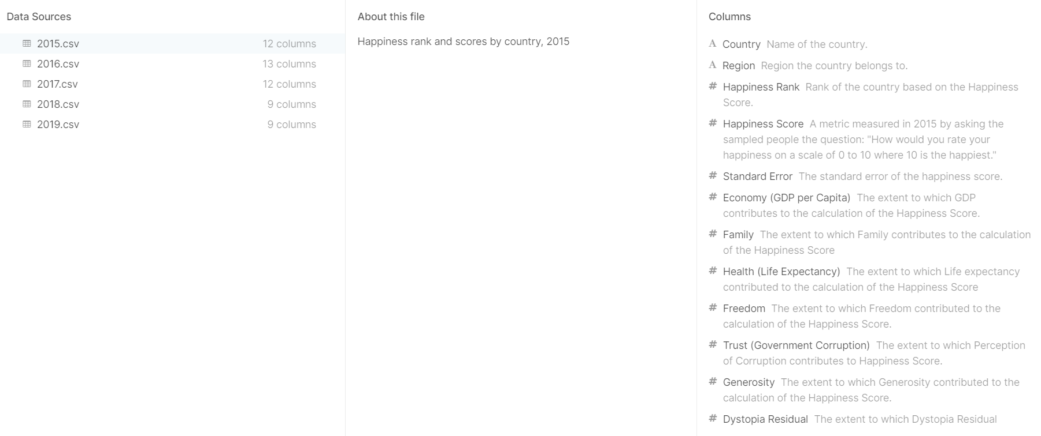

Happiness Data

Slide 6
ETL Process
Load
MongoDB
Transform
Clean Data
Extract
Data related to world Happiness
Latitude and Longitude for each Country
Merge latitude and longitude to the Happiness

Slide 7
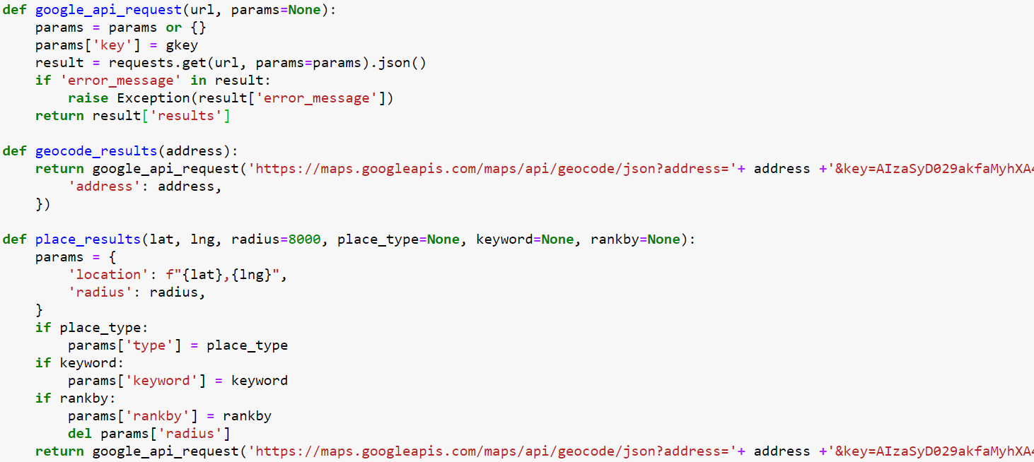


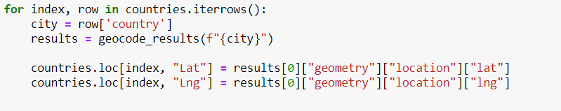
Extracting Latitude and Longitude related to each country with

Slide 8
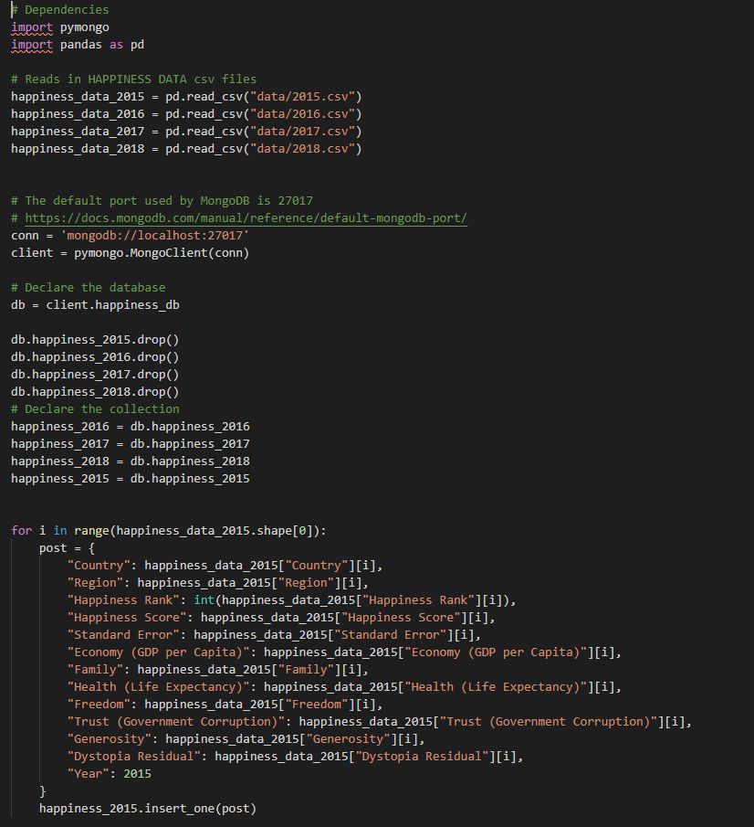

Data transformation and loading in MongoDB
Transform

Slide 9
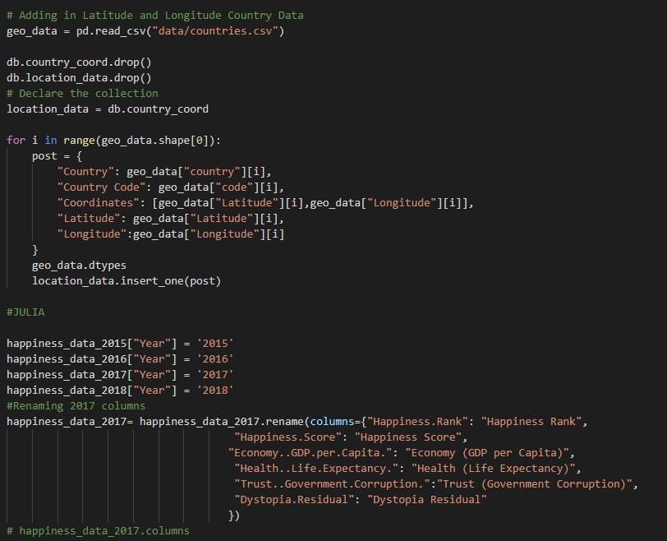
Data transformation loading in MongoDB

Slide 10

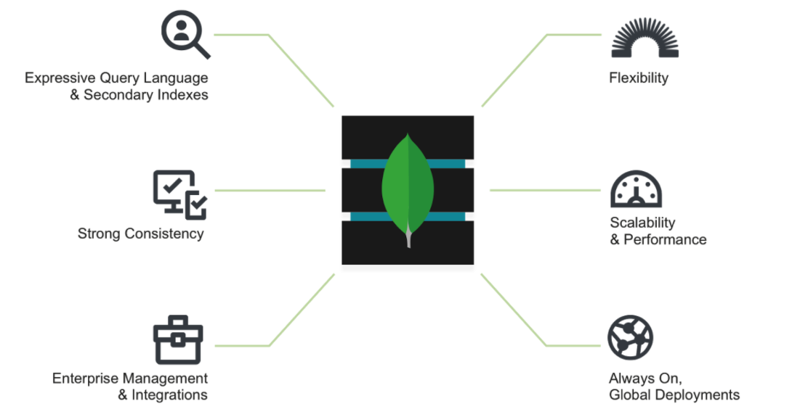
Why MongoDB?
Faster retrieval
Our data didn’t need a relational database
Notes:
I think the main reason why we chose MongoDB was because we didn’t really need a relational database. We need

Slide 11
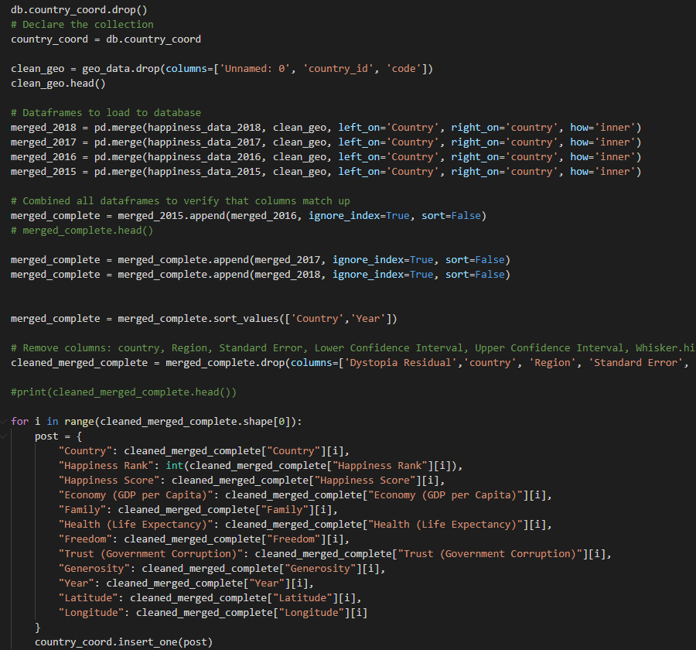
Data transformation loading in MongoDB
Load

Slide 12
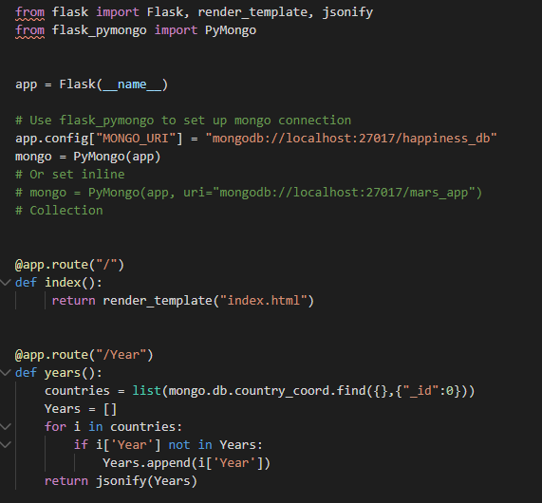
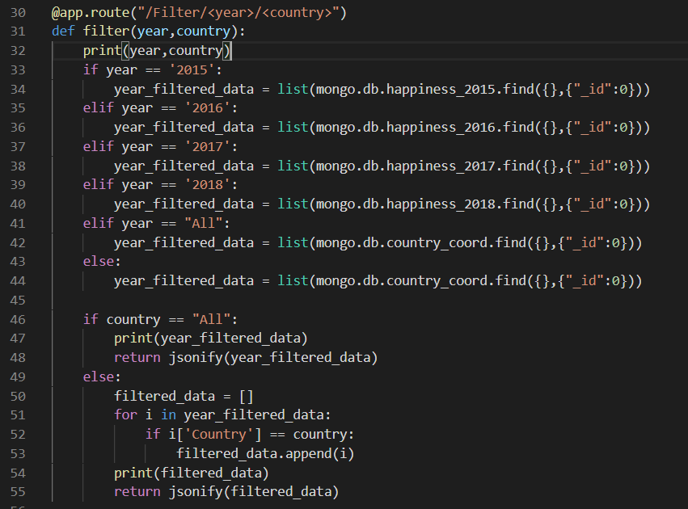

Flask App

Slide 13
Post ETL process
index
HTML and CSS
Main.css
Loaded Data into our DB ( MongoDB)
Java Script Library for our Data
Java Script
Run different Visualizations

Slide 14

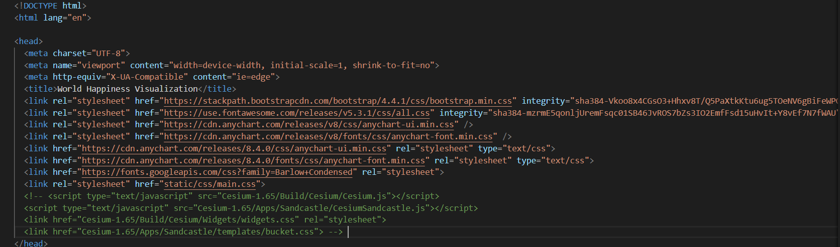
Notes:
Need to update without uncommented code

Slide 15
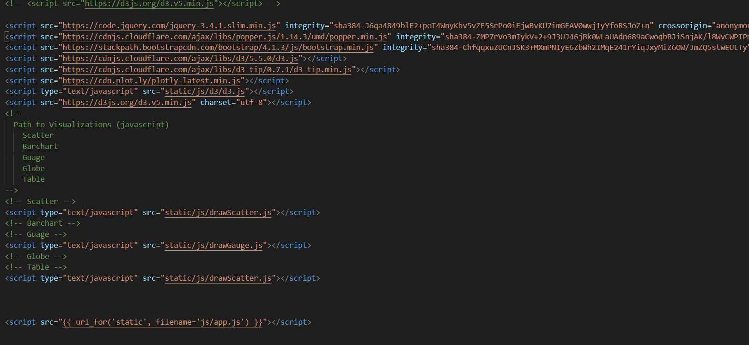
Path to Visualizations
Notes:
Need to update once we have all the paths

Slide 16
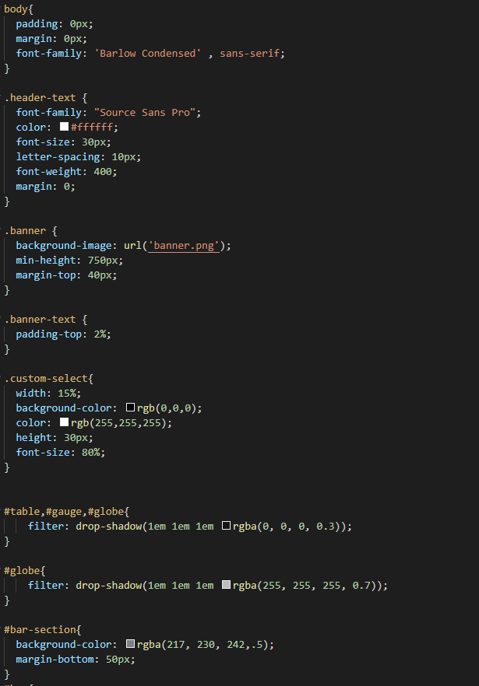
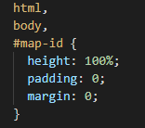


Slide 17
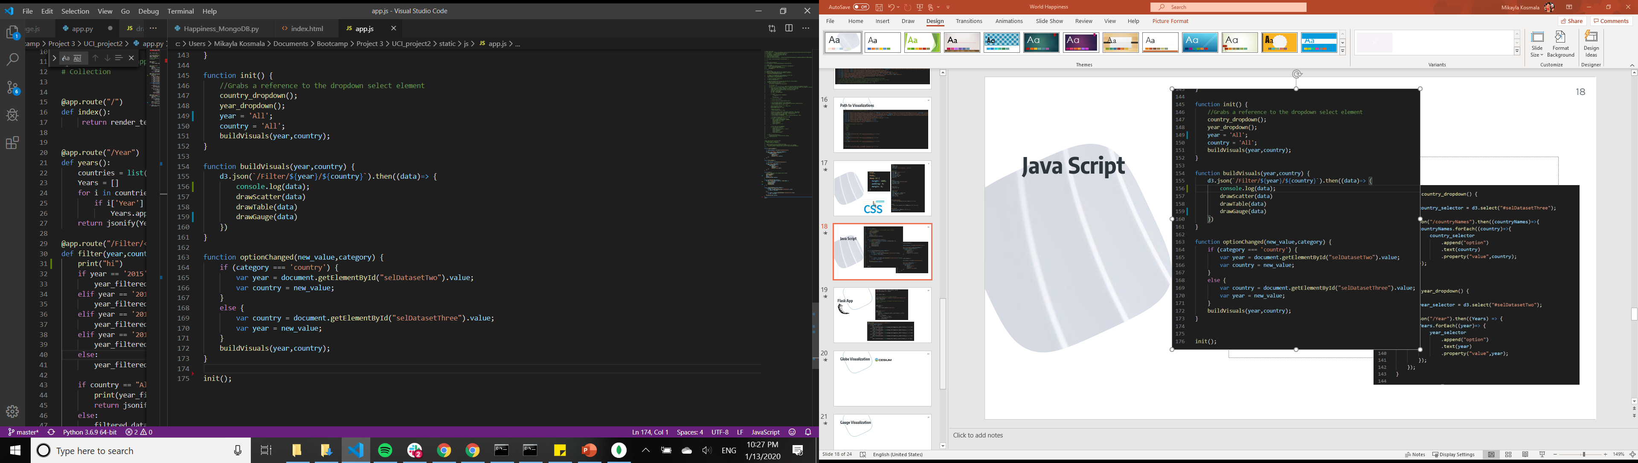
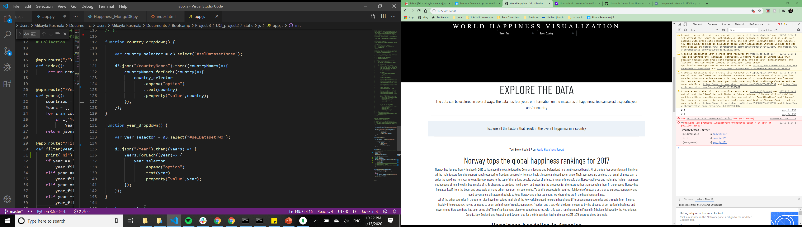
Java Script
Notes:
Need to update the screenshot on the right when other visualizations are completed

Slide 18

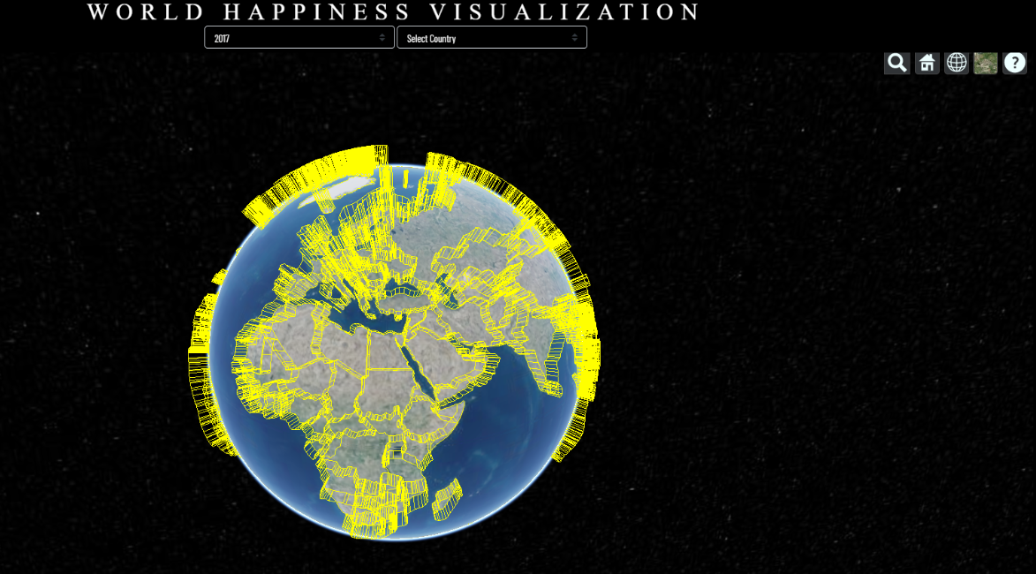
Globe Visualization

Slide 19
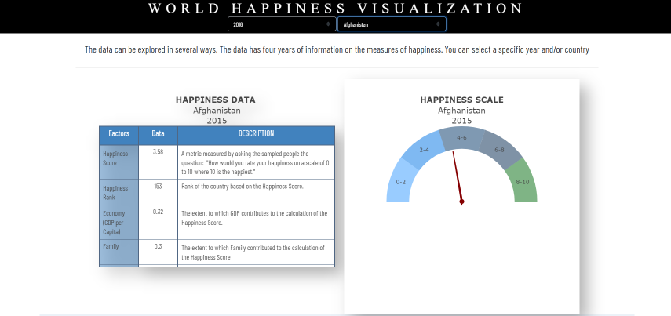
Tabular and Gauge Visualization
Notes:
Tabular and Guage Visual should be on the same slide.

Slide 20
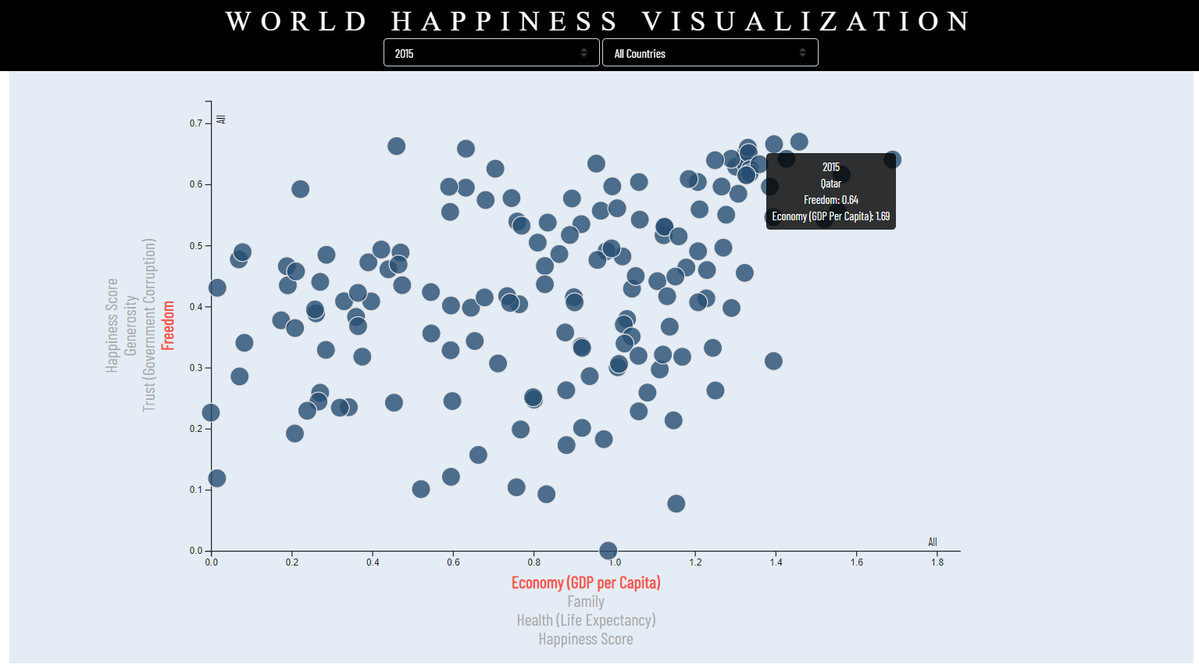
Scattered Plot

Slide 21


Want big impact? Use big image.

